Slide 1
PHP COOKIES

Slide 2
What is a Cookie?
A cookie is often used to identify a user.
A cookie is a small file that the server embeds on the user's computer.
Each time the same computer requests a page with a browser, it will send the cookie too.
With PHP, you can both create and retrieve cookie values.

Slide 3
Creating a Cookie
A cookie is created with the setcookie() function.
Syntax:
setcookie(name, value, expire, path, domain, secure, httponly);
Only the name parameter is required. All other parameters are optional.

Slide 4
Example
_{<!DOCTYPE html>} _{<?php} _{$cookie_name = "user";} _{$cookie_value = "John Doe";} setcookie($cookie_name, $cookie_value, time() + (86400 * 30), "/"); // 86400 = 1 day ?> _{<html>} _{<body>} _{<?php}
if(!isset($_COOKIE[$cookie_name])) { echo "Cookie named '" . $cookie_name . "' is not set!"; }
_{else {} echo "Cookie '" . $cookie_name . "' is set!<br>"; echo "Value is: " . $_COOKIE[$cookie_name]; } ?>
<p><strong>Note:</strong> You might have to reload the page to see the value of the cookie.</p> _{</body>} _{</html>}

Slide 5
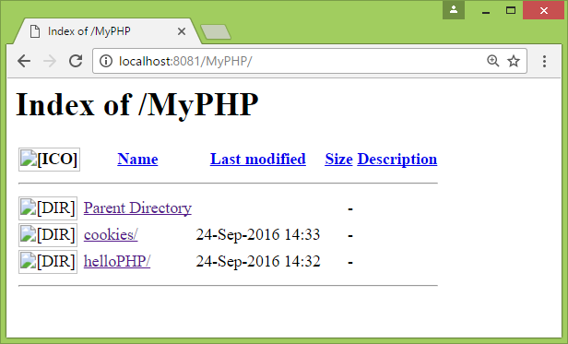
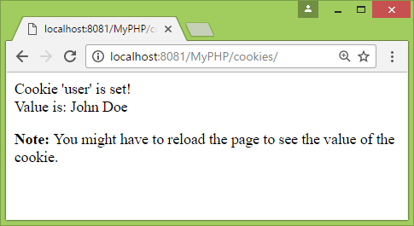
OUTPUT

Slide 6
Modifying & Deleting Cookie
To modify a cookie, just set (again) the cookie using the setcookie() function.
Delete a Cookie:
<?php // set the expiration date to one hour ago setcookie("user", "", time() - 3600); ?>

Slide 7
Check if cookie is enabled
<?php if(count($_COOKIE) > 0) { echo "Cookies are enabled."; } else { echo "Cookies are disabled."; } ?>

